Slide 1
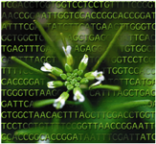




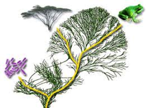
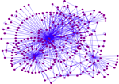
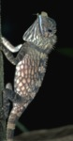
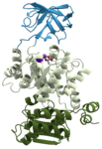
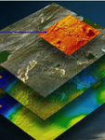
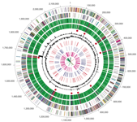
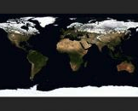
Documenting biodiversity on ultramafic outcrops: Scientific infrastructure enabled research in unusual environments
Reed Beaman
University of Florida

Slide 2
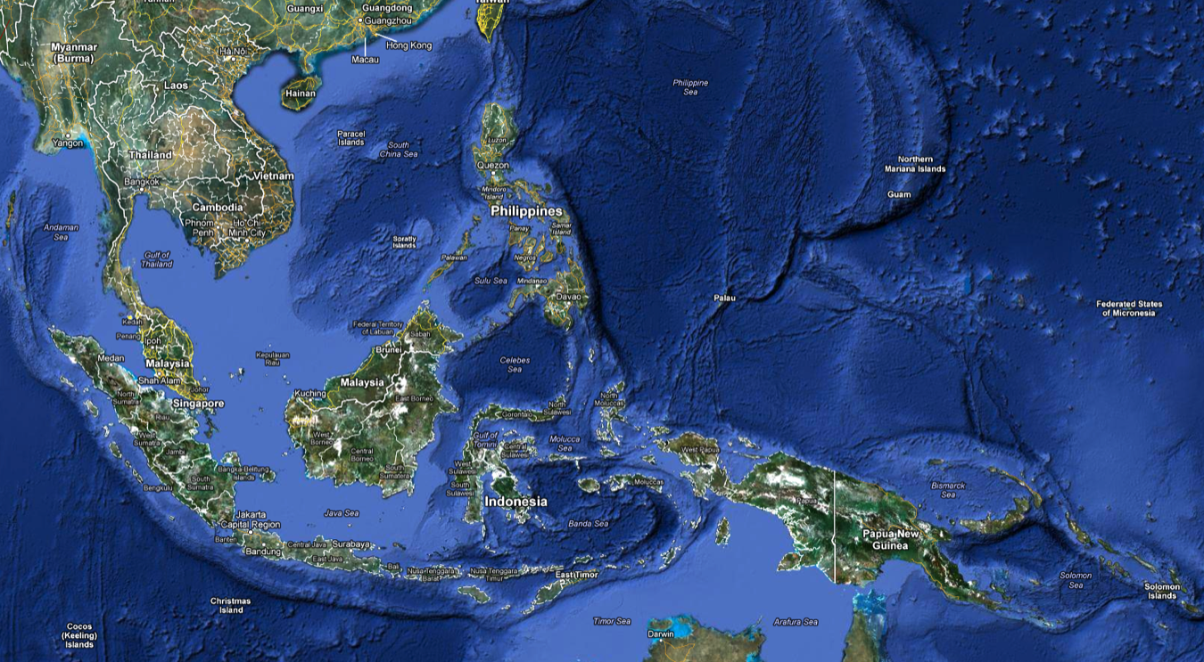
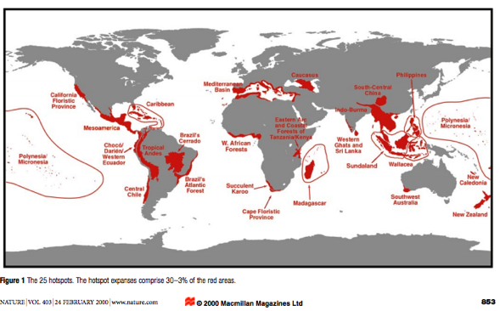
SE Asia – Biodiversity Hotspot
Wallace’s Line

Slide 3
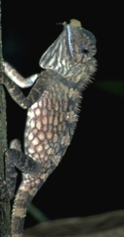
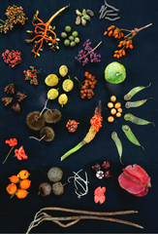

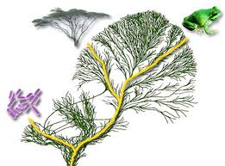
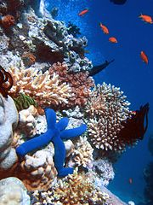
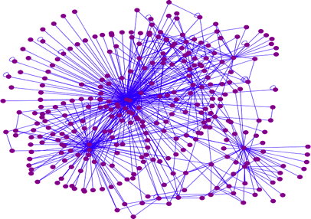
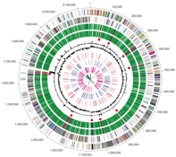
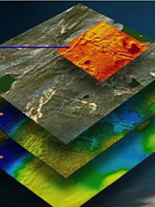
What is Biodiversity?
Genetic
Phylogenetic, genomic
Taxonomic
Organisms -> species
Functional
Molecular -> Ecosystem

Slide 4
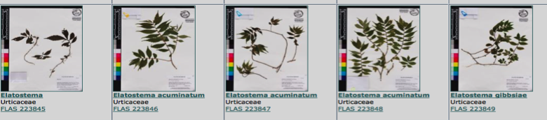
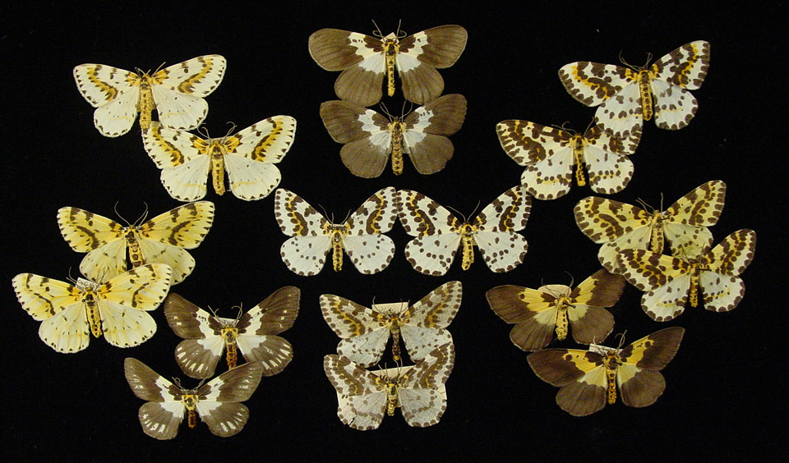
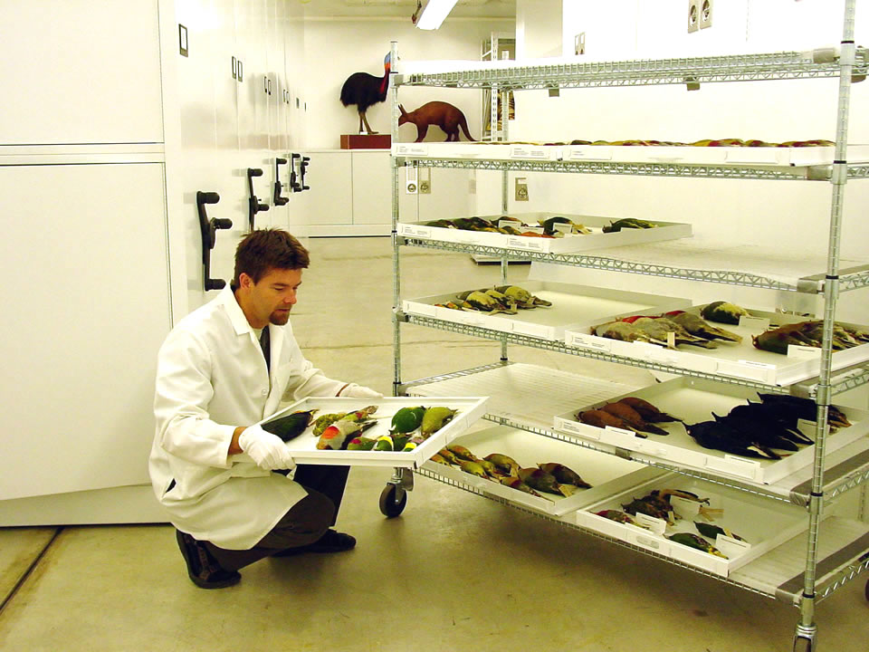
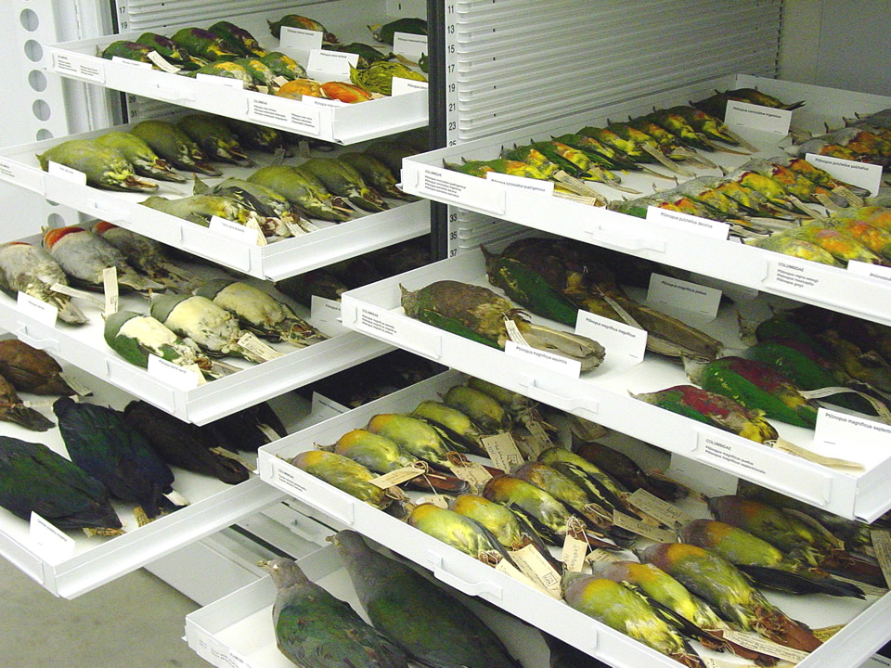
The Case for Collections: Documenting Biodiversity
Ca. 2 million named species – plus all the unamed (microbes)
300,000 named plant species
2.6 billion natural history specimens
More than 1 billion biological specimens
Notes:
On the basis of species per unit area, Mount Kinabalu may have one of the most diverse floras on earth. Ten years ago it was thought that the flora included about 4,000 species of vascular plants (Beaman & Beaman 1990). A few years later that figure was revised to about 4,500 species, and now it appears that the total will be 5,000 or more taxa. This extraordinary diversity occurs in an area of only 1250 km². Over 200 families and 1,000 genera occur in the flora. Diversity and distribution patterns in the Kinabalu flora have been discussed by Beaman and Beaman (1990).
An analysis of the global distribution of species diversity in vascular plants by Barthlott et al. (1996) ranked a northern Borneo centre (principally Mount Kinabalu) as one of the six highest global diversity centres in the world, with more than 5,000 species per 10,000 km². Our new data indicate that 5,000 or more taxa may occur in an area of about 12% that unit size. Roos (1998) indicated that the Malesian vascular plant flora consists of about 42,000 species in an area of 3.1 million km². Thus the relatively small area encompassed by Kinabalu may include as 14% of the entire Malesian flora.
The high species diversity of Mount Kinabalu may be the result of a combination of factors, such as (1) great altitudinal and climatic range from tropical rain forests near sea level to freezing alpine conditions at the summit; (2) precipitous topography causing effective geographic and reproductive isolation of species over short distances; (3) geological history of the Malay Archipelago involving movement of several tectonic plates; (4) a diverse geology with many localized edaphic conditions, particularly the serpentine or ultramafic substrates; (5) frequent climatic oscillations influenced by El Niño events; and (6) environmental instability resulting from such causes as landslides, droughts, river flooding and glaciation. Landslides are a particularly prominent feature of the Kinabalu landscape. New ones occur frequently and provide open habitats for plant colonization. Likewise, droughts are frequent events, probably occurring on the average of every four years; the most recent, extremely serious one was in 1998 (Kitayama et al. 1999; Kudo & Kitayama 1999). A substantial part of the high species diversity likely has resulted from catastrophic selection by droughts of adapted genotypes on ultramafic substrates (Beaman & Beaman 1990).

Slide 5
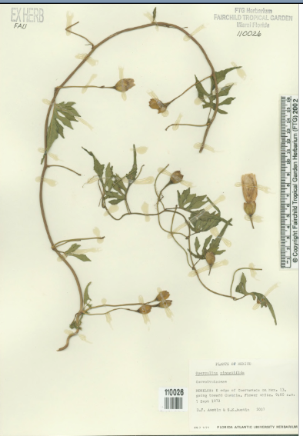
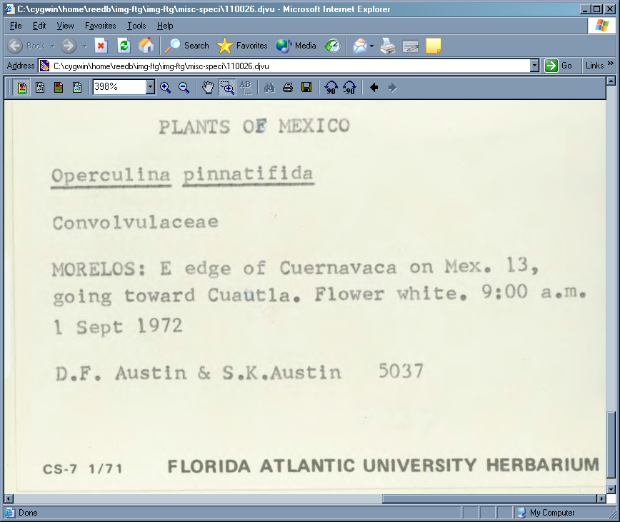
Specimen label data

Slide 6
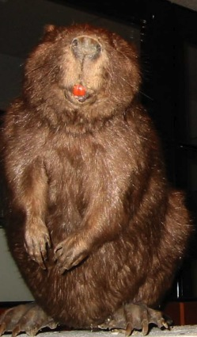
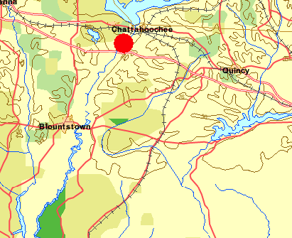
Every specimen has a place from whence it came
Longitude: -84.85436 dd
Latitude: 30.642794 dd

Slide 7
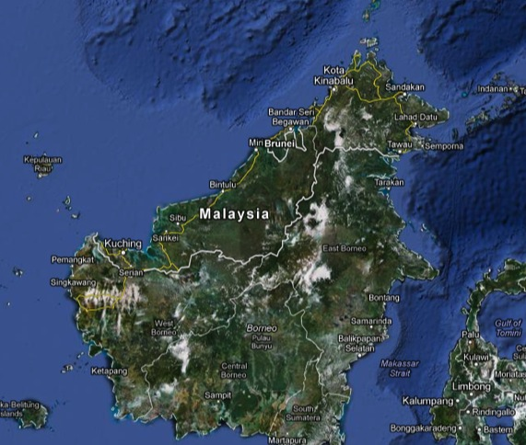
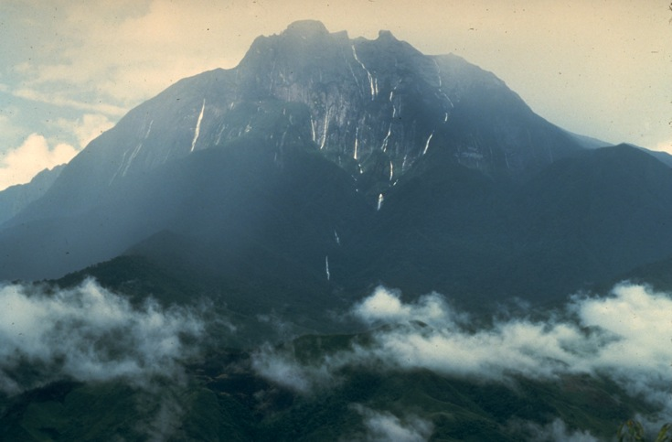
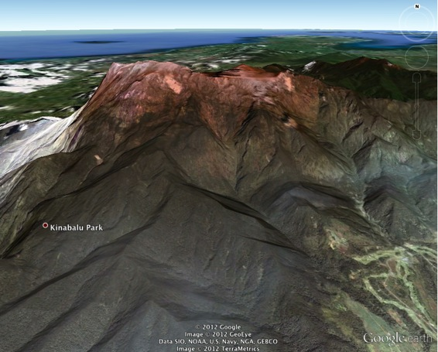
Mount Kinabalu
Sabah, Malaysia
On island of Borneo
4095 m. elevation
World Heritage site
Notes:
Kinabalu Park,

Slide 8
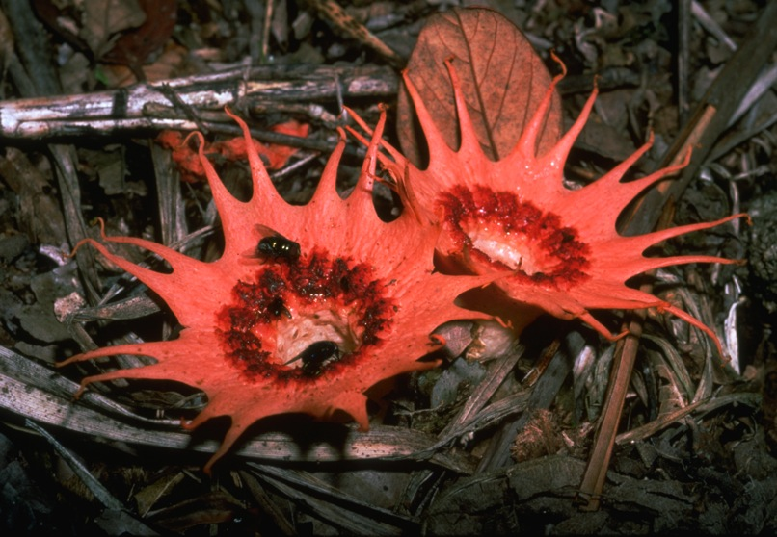
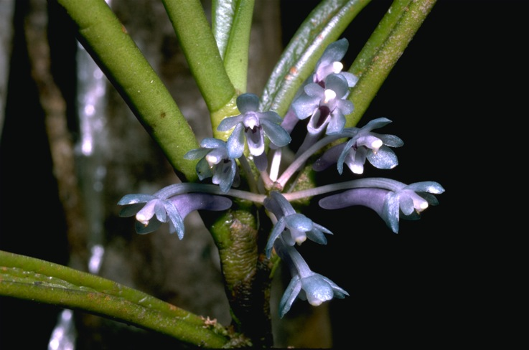
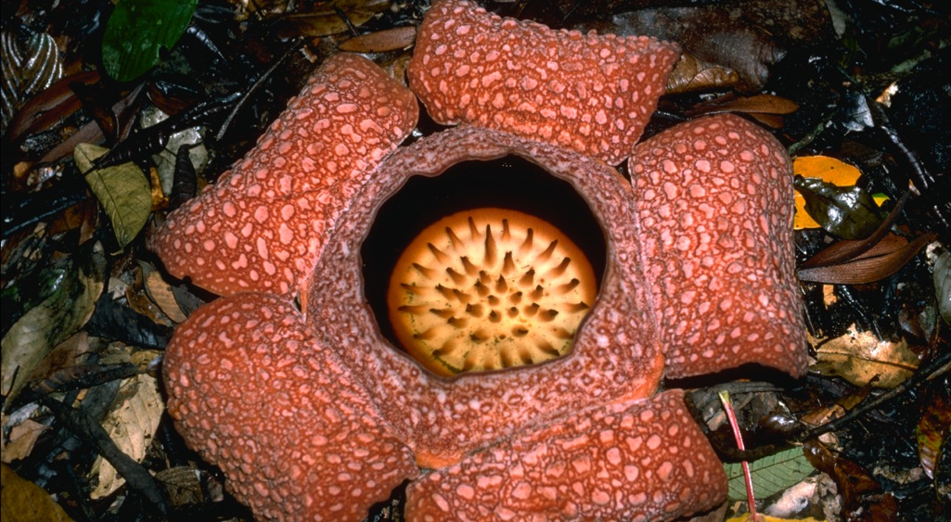
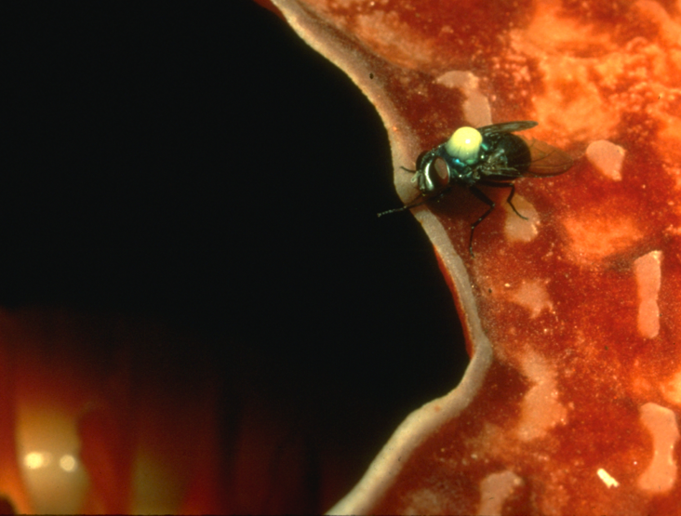
Notes:
One of the richest floras of the world per sq. kilotmeter
5000 species of vaslcular plants in 1200 sq. km in Kinabalu Park

Slide 9
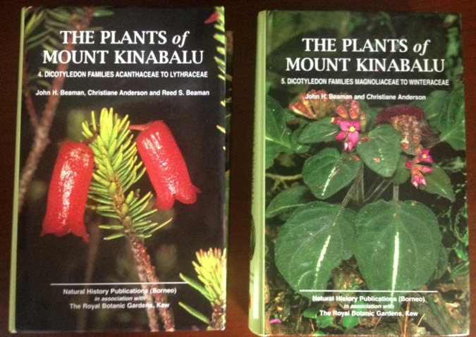
Flora of Mount Kinabalu database
Over 65,000 specimen records from collections world-wide
Used to produce series of volumes
Ferns, gymnosperms, monocots, orchids, dicots
Documents more than 5000 plant species
Georeferenced to localized standard place-names
Notes:
Focused approached to understanding biodiversity – small project
Contains detail information for small area.

Slide 10
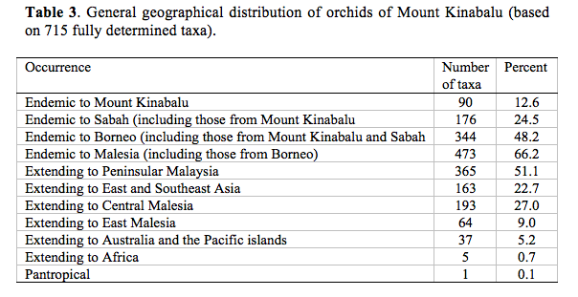
Mount Kinabalu orchid endemism

Slide 11
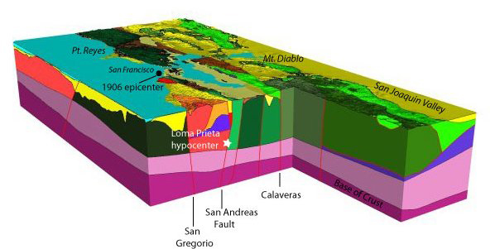
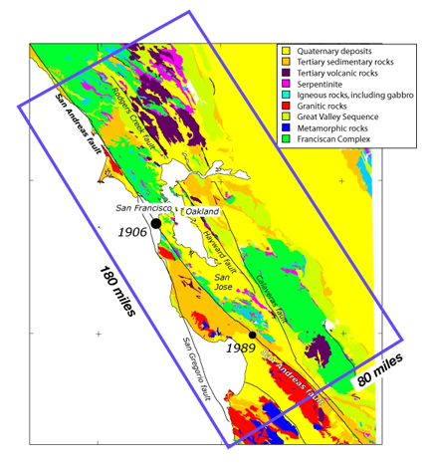
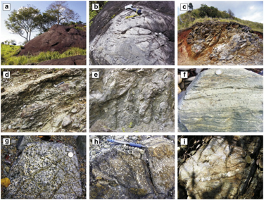
Ultramafic (serpentine outcrops)
Global distribution
High in Fe-Mg minerals, metals, rare-earths
Unsuitable for many organisms, agriculture
Outcrops in tectonically complex areas – sourced from lower crust, upper mantle

Slide 12
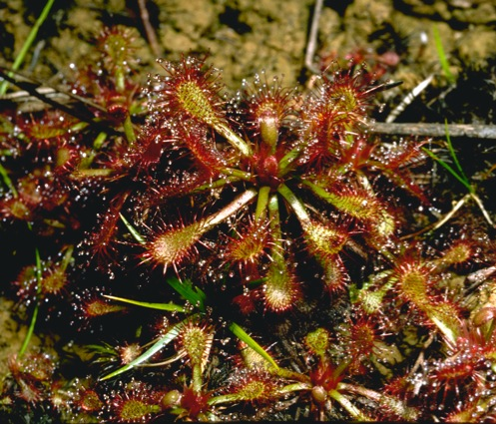
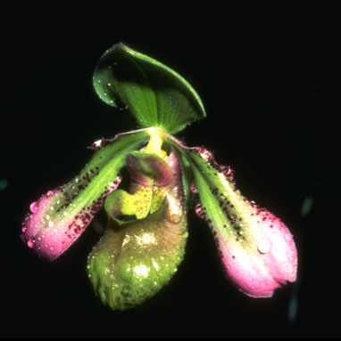
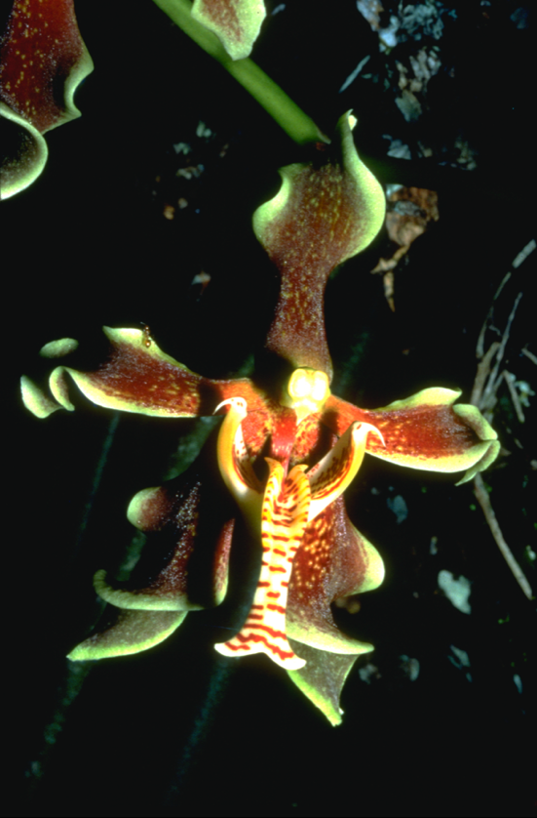
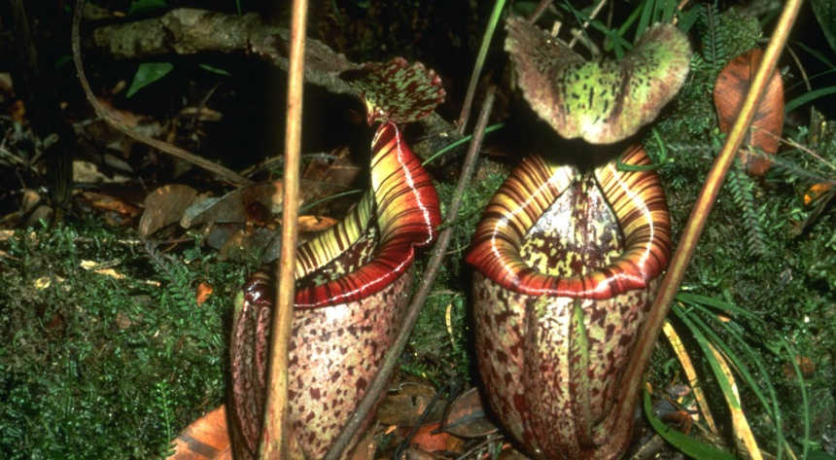
Kinabalu ultramafics

Slide 13
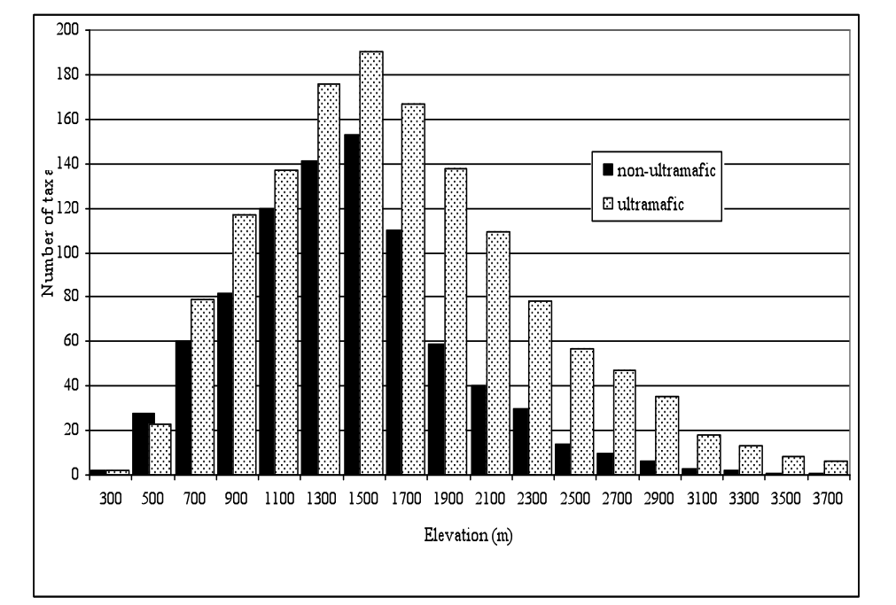
Number of taxa: ultramafics vs. other habitats on Kinabalu by elevation

Slide 14
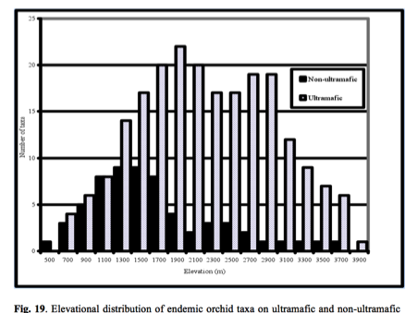
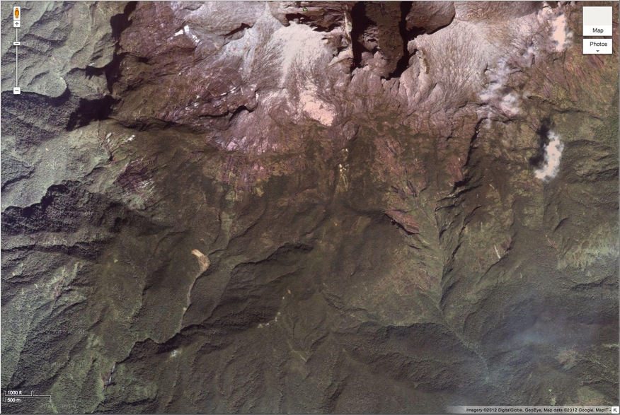
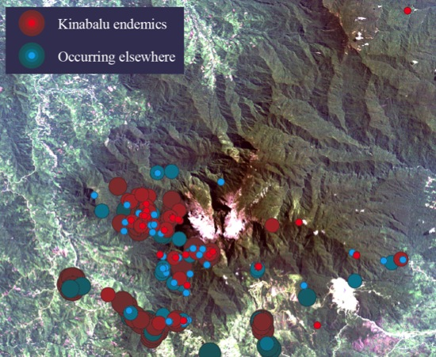
Kinabalu endemic orchid taxa – ultramafics by elevlation
Higher elevation habitats geographically isolated

Slide 15
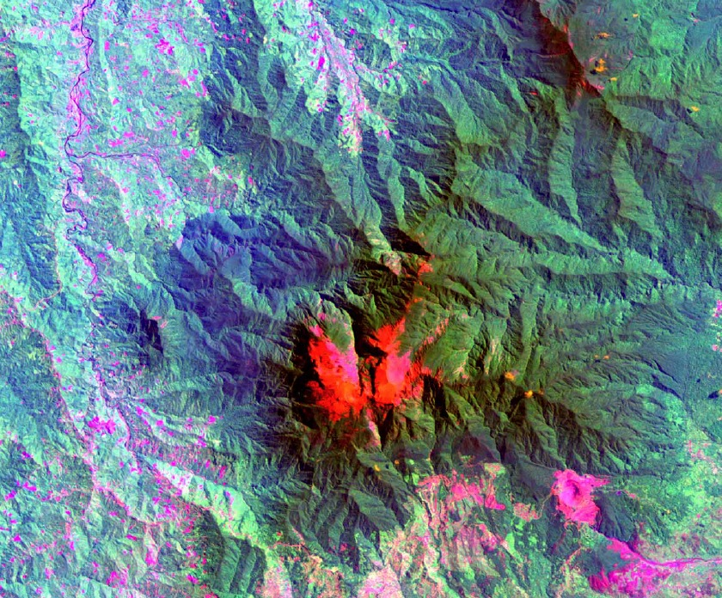
Notes:
Landsat TM pseudocolor image of Mount Kinabalu, produced by
applying bands 7, 6, and 4 to the RGB color model. Low elevation ultramafic areas are
quite evident with this band combination. One such area is circled.

Slide 16
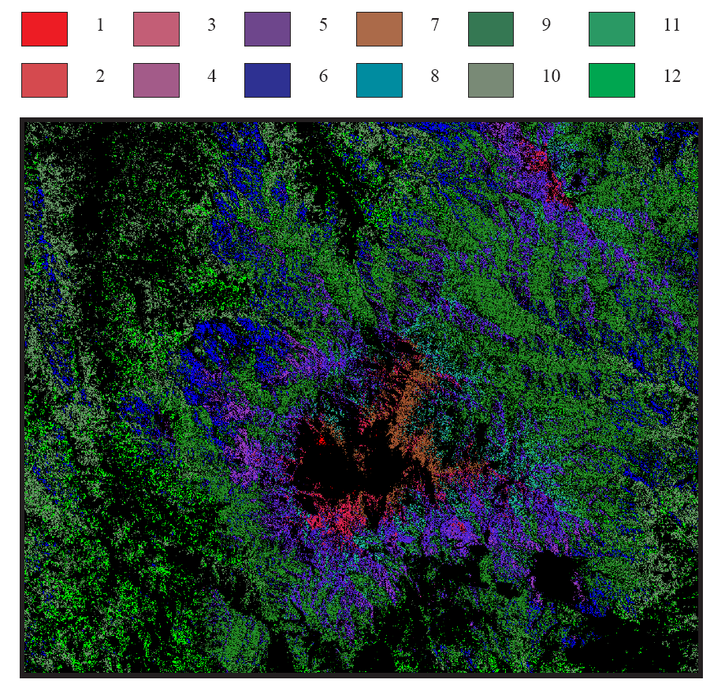
Notes:
Maximum likelihood classification Landsat image based on 12 vegetation classes. Black areas represent unclassified pixels, primarily in the summit zone and in disturbed areas.

Slide 17

Factors driving high species diversity
Elevation and climatic range
Precipitous topography causing
Geographic and reproductive isolation over short distances
Geological history of the Malay Archipelago
Diverse geology, localized edaphic conditions, ultramafic substrates;
Environmental instability: landslides, droughts, El Niño, flooding and glaciation

Slide 18
Role of Cyberinfrastructure: A matter of scale
Access to data: structure, metadata, provenance
Digitization: Billions of objects
Long-term archiving: Museums have a business model
HPC, Software and tools
Collaboration: Start small and build up: PRAGMA “Expedition” on Kinabalu Biodiversity

Slide 19
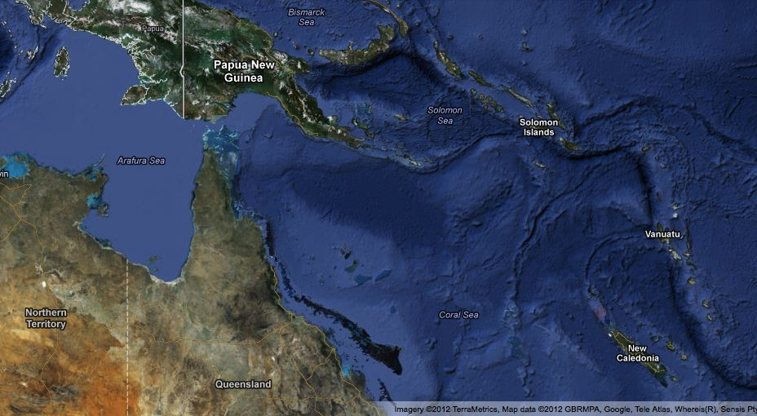
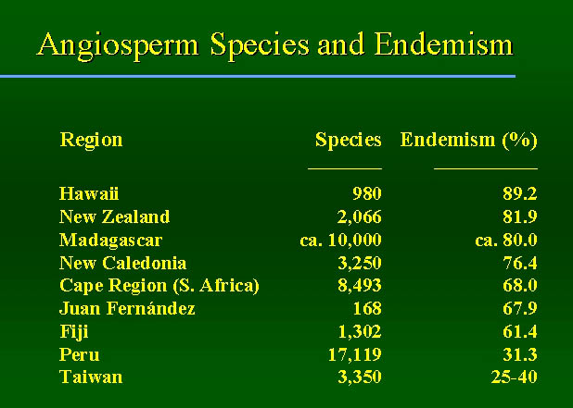
New Caledonia – Another Pacific Rim hotspot

Slide 20
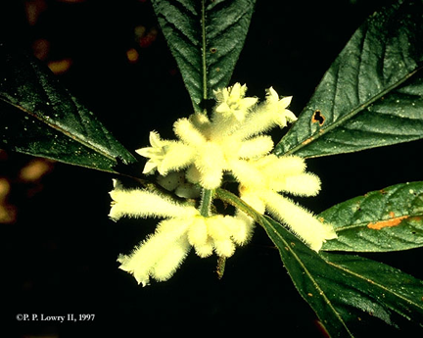




New Caladonia – Another ultramafic hotspot
Source: P. Lowry, www.mobot.org
Notes:
The flora on New Caledonia's ultrabasic substrates (primarily in the moist evergreen forests and maquis) is rich in species and has a very high degree of endemism (90.6%; see above). At the same time, very few of the island's non-endemics are found on ultrabasics: of the 740 native species shared with other areas, only 173 (23.4 %) occur on ultrabasics, while 587 are found on other substrates, with only 20 of these occurring on both ultrabasics and non-ultrabasics (data derived from Morat, 1993).

Slide 21


Amborella trichopoda
Basal Angiosperm
Endemic to New Caledonia
Not on Ultramafic substrates
Solis et al 2008.
Notes:
Solis et al 2008. (A) Phylogenetic tree based on maximum likelihood (ML) analysis of the inverted repeat (IR) region of the plastid genome for 39 angiosperms and two gymnosperm outgroups (Pinus and Cycas) (Piedrahita et al., unpublished data). (B) Summary phylogenetic tree of major lineages of angiosperms, based primarily on analyses of the Angiosperm Phylogeny Group (2003), Moore et al. (2007) , and Jansen et al. (2007) , as described in text.

Slide 22

Placing value on natural systems
The focus is on ecosystem services and level of threat
Ecosystem function: Hydrology, sequestration, human use, etc.
Potential for negative impact (if it’s not at risk it’s not bankable)
Biodiversity value – beyond the timber
Source: NCAR

Slide 23

Biodiversity valuation
Standing forests have value other than just timber
PV_{B} is the present value for biodiversity values;
B the biodiversity function; and
P_{b} is the biodiversity shadow price
P_{b} and B are not easy to value in current practice
Hartman (1976) modified by Caparros (2003)
Notes:
Shadow pricing is the process of deriving price for goods or services where there is no monetized market or the market fails to price based on true value
That is the outcome if the agent internalizes
carbon sequestration as well as biodiversity. If this
is the case, its decision will lead to the social
optimum (we assume that the society’s objective
function is Eq. (4)). The problem is that currently
only G(T) is internalized by private agents and
that the implementation of the Kyoto Protocol
will only internalize carbon values, leaving biodi-
versity out of the market and therefore out of the
decision process. To correct this deviation, the
conventional approach is to estimate Pb in order
to establish an incentive to ensure that the agent’s
strategy coincides with the social optimum. The
problem arises from the difficulty to estimate Pb
and B (especially Pb), which will probably imply
that biodiversity will remain outside of the markets

Slide 24
Biodiversity services as ecosystem services – some requirements
High-throughput cyberinfrastructure (CI) to model and quantify biodiversity services,
phylogenetic (taxonomic),
genetic, and functional services (e.g., natural products chemistry)
Human valued services: ethnobiological uses, ecosystem services, etc.
Represents highly biodiverse regions
Includes many of the marine and terrestrial environments of the ASEAN countries.
Support workflows and from comprehensive sampling, sensor networks, collection of vouchers, chemical assay, tissues, molecular (DNA and sequences).

Slide 25


Making collections infrastructure and cyberinfrastrucure relevant to economics
Biological collections are the ultimate documentation of what, where, and why for vouchering biodiversity research
Communicate value of collections based data through education and outreach
Economic modelers can only use information readily available. Biodiversity and informatics collaborators must
Provide raw and synthesized data
Provide [more] complete data sets
Provide a basis for trust

Slide 26

Many Thanks!
Peter Arzberger
Out PRAGMA hosts
PRAGMA biodiversity expedition collaborators (especialy to Jim Beach and Beth Plale for sending Uma and Aimee)
US National Science Foundation
Family and friends

